Slide 1
The Unlocker ^{+ the home assistant}
150698P
H. A. C. K Wijesena

Slide 2
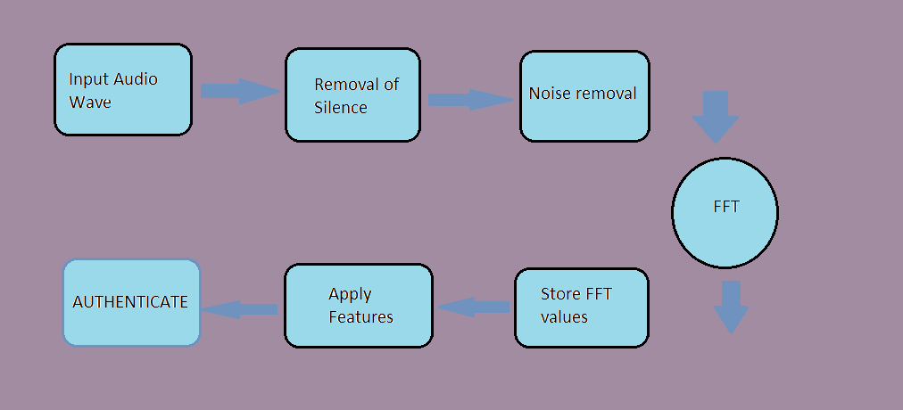
The process flow

Slide 3
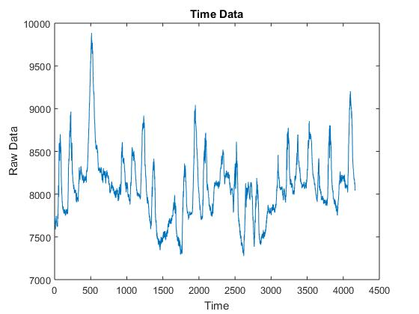
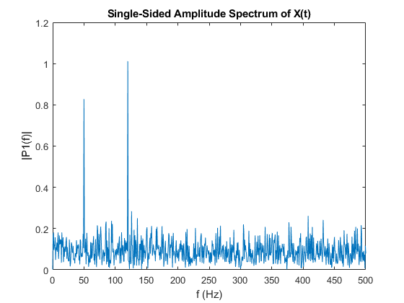
Wave Form representation with FFt

Slide 4
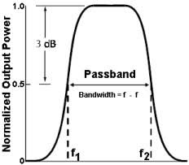
Noise removAl
Cut off Signals with less Frequency
Amplitude Filter Based on the Previous Data
Band Pass Filter

Slide 5
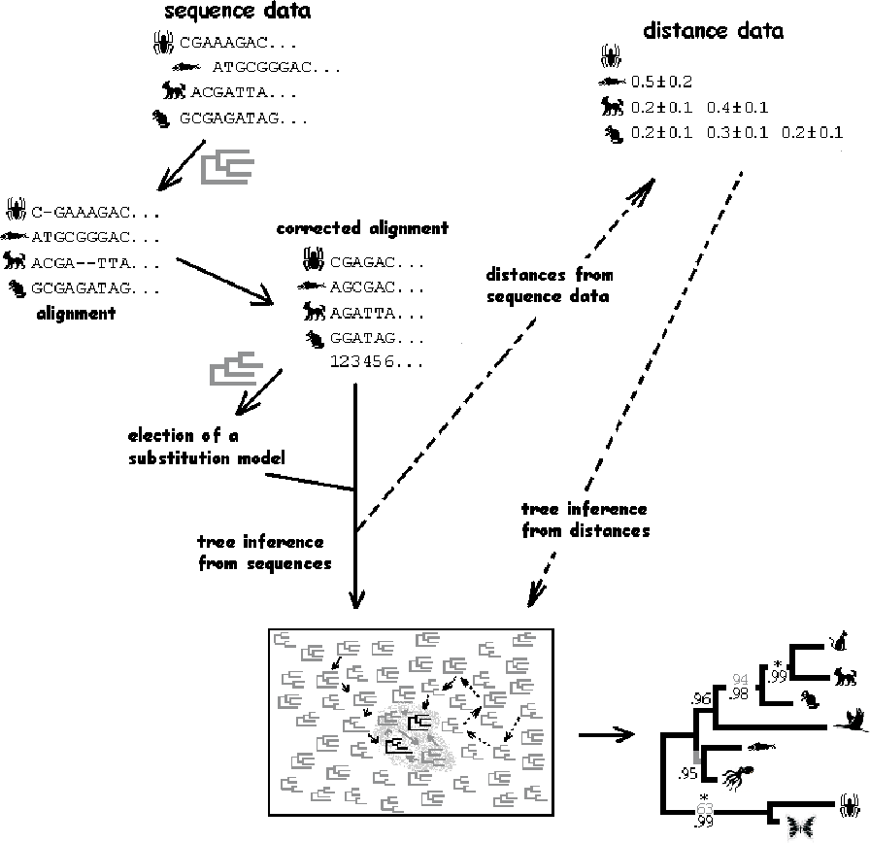
Statistical Data Analysis

Slide 6
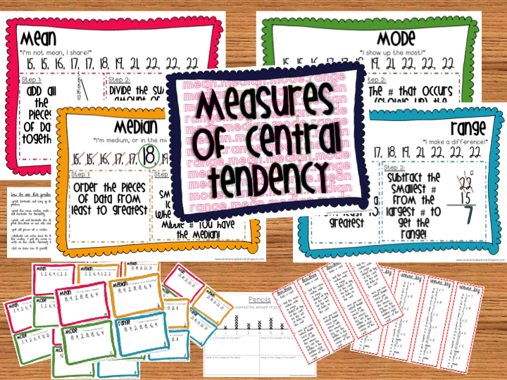
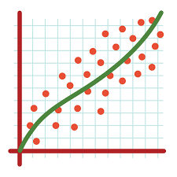
processes

Slide 7

Whom to authorize??

Slide 8

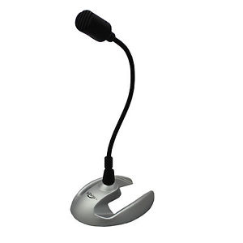
You are authorized

Slide 9
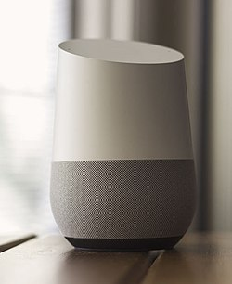
Further Evolution of the project

Slide 10
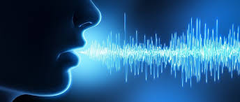
No internet Not smart
Work with wi-fi with no internet and make your home SMART
On device NLP to make your life SMART
Keyword authorization and Command Detection

